Slide 1
PAY your Membership, Seminar fees and etc… thru UNIONBANK!
You may now pay your Membership, seminar fee, etc … over-the-counter by going to the nearest UnionBank Branch or via UnionBank Online!
REQUIRED REFERENCES
Name of Member 1-30 Mandatory
Purpose of Payment 5-20 Mandatory
CPA Number 2-10 Mandatory

Slide 2
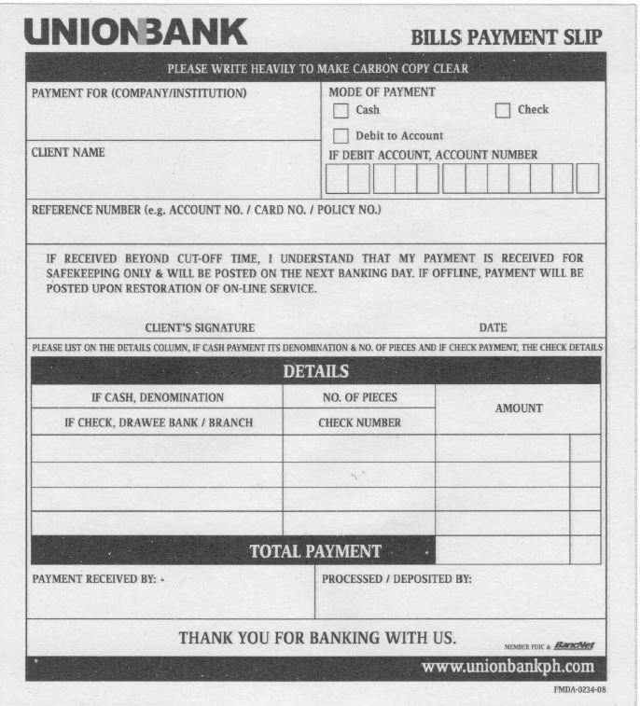
Over the Counter(OTC)
Pay thru any Unionbank branchand fill up Bills Payment Slip
PICPA CEBU CHAPTER
JUAN DELA CRUZ
JUAN DELA CRUZ / SEMINAR 12-13-19 / 1234567
Required References:
Name of Member 1-99 (Alpha-Numeric Characters)
Purpose of Payment 1-80 (Alpha-Numeric Characters)
CPA Number 1-70 (Alpha-Numeric Characters)

Slide 3
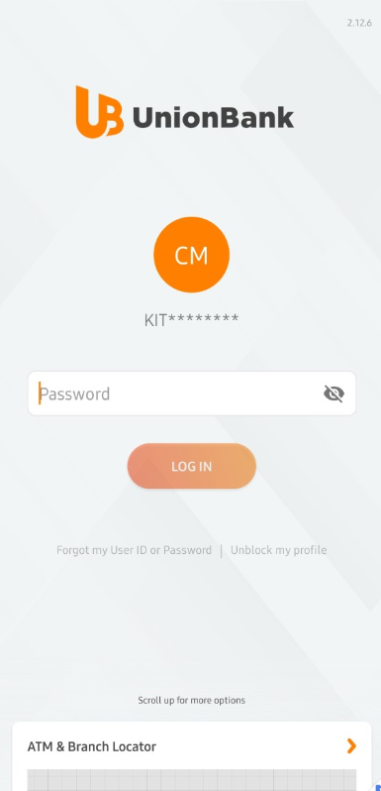
Login to UnionBank via:
Personal Banking Online
Business Banking Online (The Portal)
UnionBank Mobile App

Slide 4
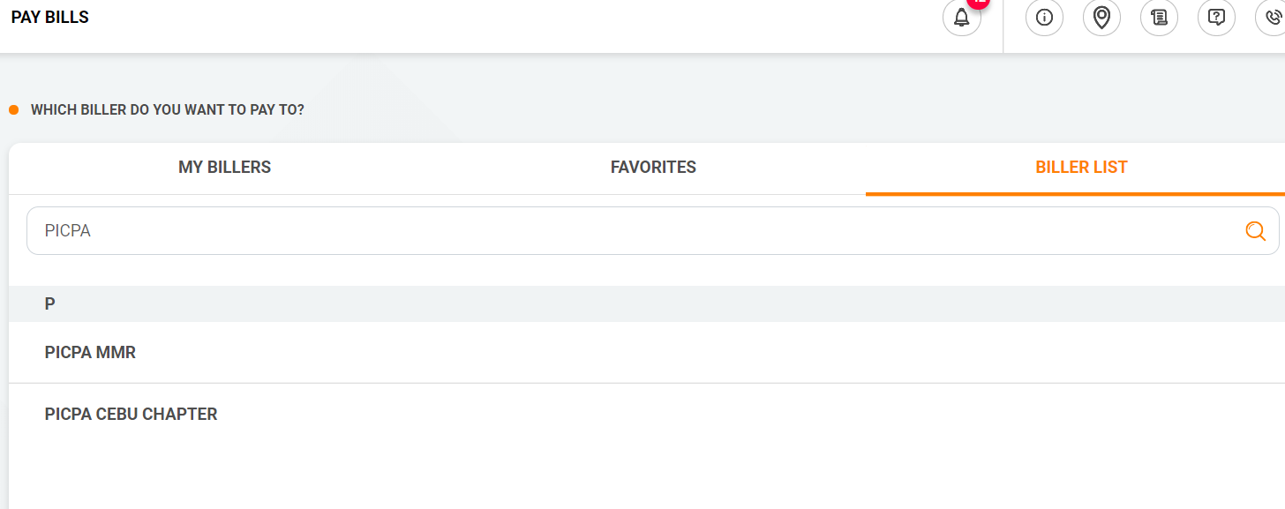
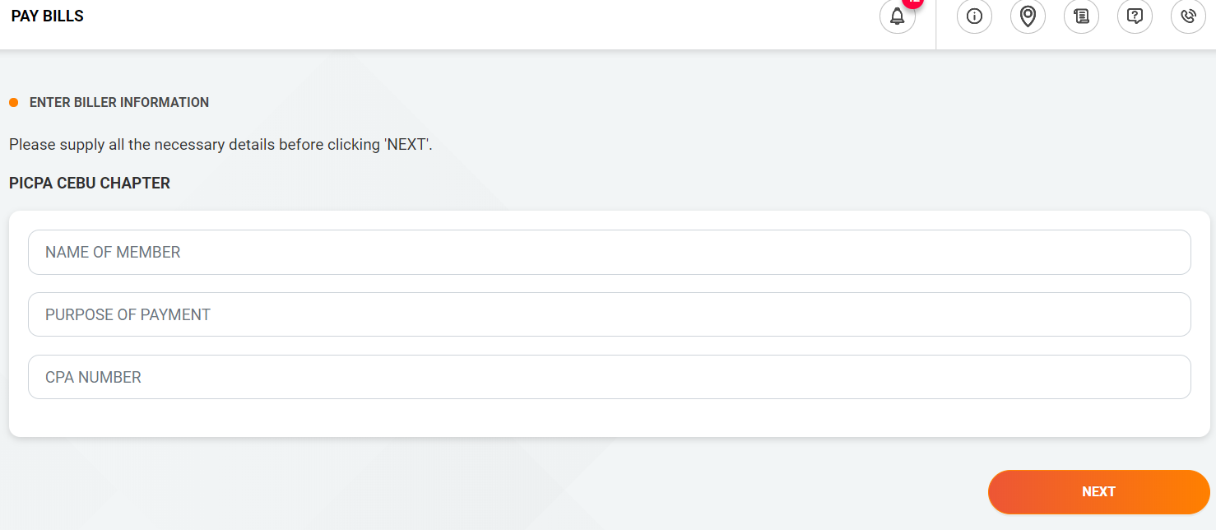
Search PICPA CEBU CHAPTER in the Biller List
Enter the the required information:
NAME OF MEMBER
PURPOSE OF PAYMENT
CPA NUMBER (Please fill out NA or Not Applicable to those who don't have CPA numbers)
Click Next and Confirm Payment

